Slide 1
Autonomous Checkout System
Supervised by
Dr. Junaid Akhtar
Co-supervisor
Dr. Muhammad Hussain

Slide 2
About
Mubashar Nisar BSc(Hons) Computer Science
Muhammad Hamza
BSc(Hons) Computer Science

Slide 3
What is the project?
Person Detection
Product Picked & Unpicked Classification
Product detection
Product Tracking
Product Classification
Owner Resolution
Interface using Streamlit

Slide 4
What is to be done?
Person Detection
Picked & Unpicked Classification
Product Detection
Product Classification
Product Tracking
Interface using Streamlit

Slide 5
Done
What we have done?
How ?
Person Detection
Picked & Unpicked Classification
Interface using Streamlit
Used Keras binary classifier for picked & Unpicked binary classification
Trained on Dataset collected by ourselves

Slide 6
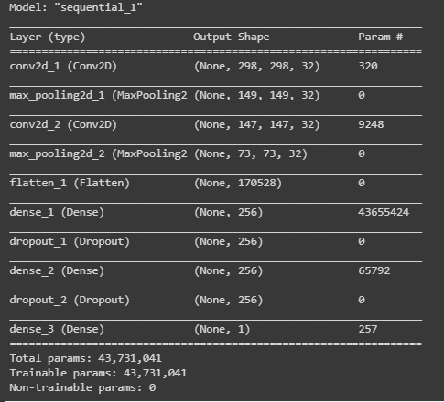

Model Summary

Slide 7
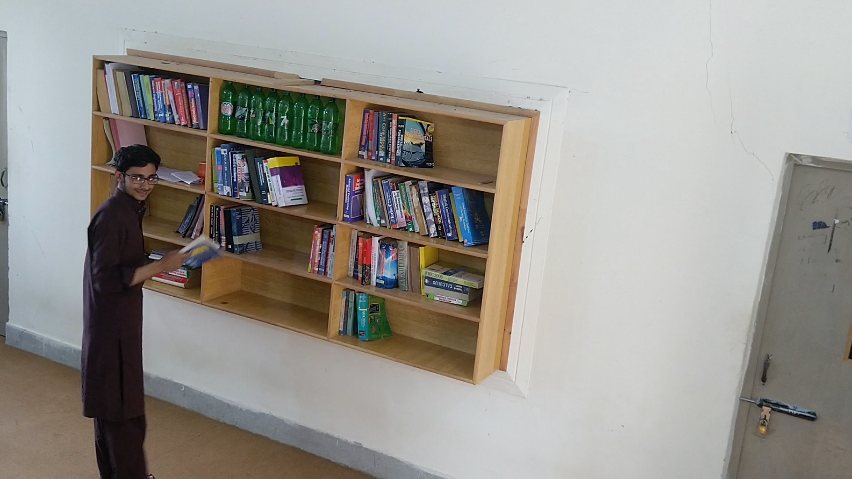
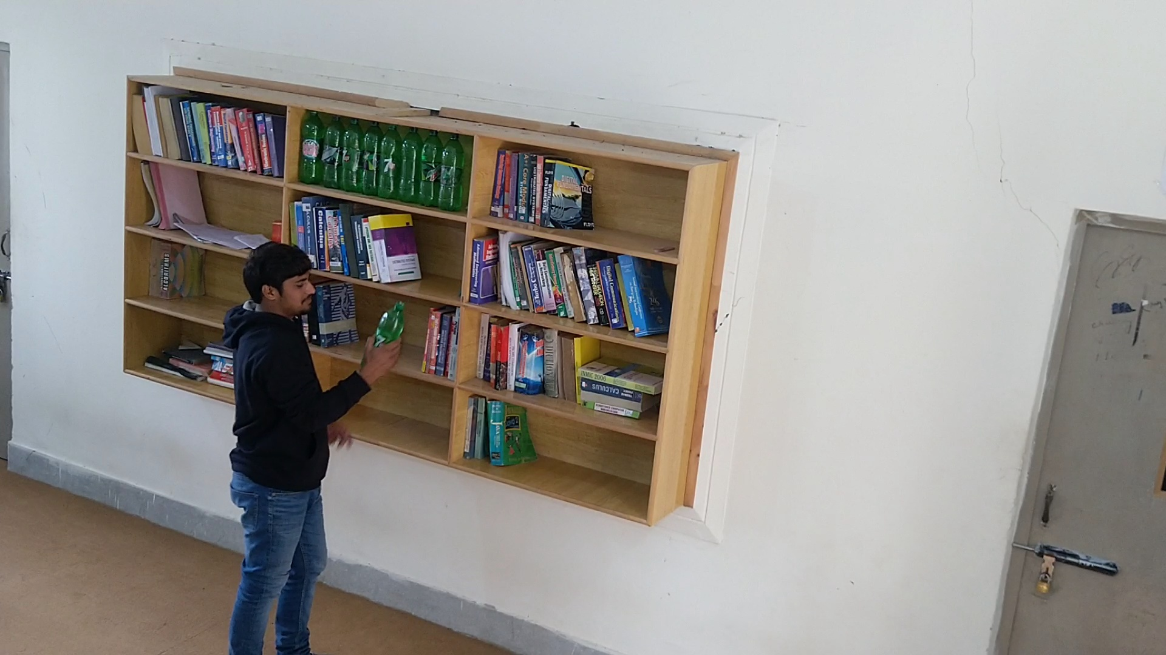
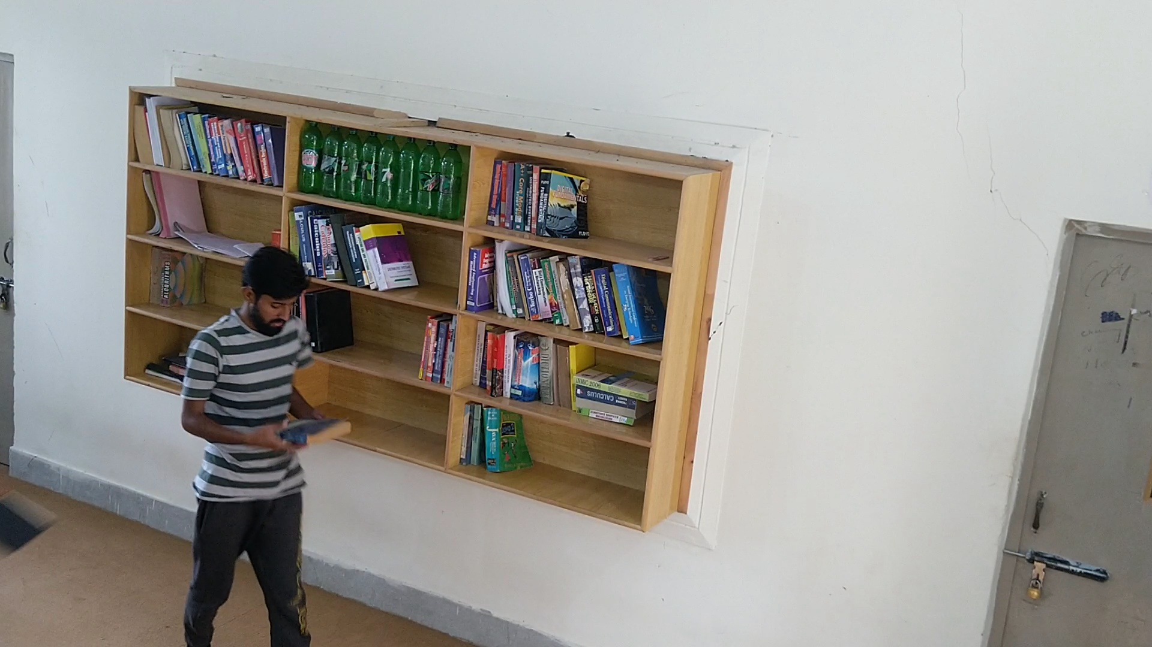
Dataset Collection
Collected Dataset from Namal study room, where we used book shelve as products shelve.
Mounted camera at hieght about 10ft and angle 45° from shelve.

Slide 8
Dataset Training & Testing Split
Training 2000: 80%
Testing 400: 20%

Slide 9
Accuracy
Training Accuracy: 93%
Vallidation Accuracy: 88%
Testing Accuracy: 80%

Slide 10
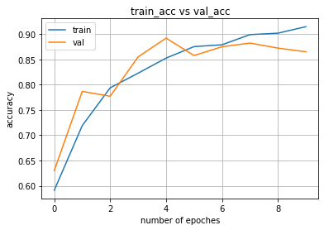
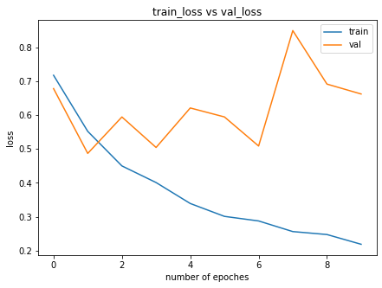
Acurracy

Slide 11
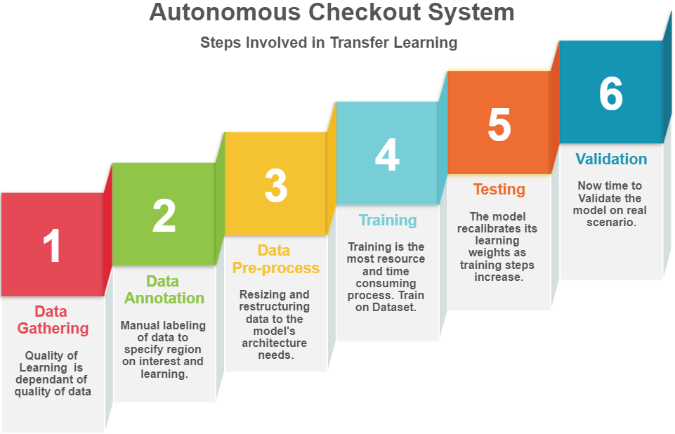

Slide 12
Demo

Slide 13
Refrences
https://opencv.org/
https://keras.io/
https://blog.keras.io/building-powerful-image-classification-models-using-very-little-data.html
https://machinelearningmastery.com/
https://standard.ai/

